Slide 1
January 13, 2015
Enterprise Machine Learning Bootcamp
Markus Noga Machine Learning Incubation
Image credits: bestfreejpg.com

Slide 2
Disclaimer
This is not about turning all available matter in the universe into computronium (a.k.a Ray Kurzweil’s singularity)
This is not about super-human AI taking over the planet (a.k.a. Skynet)
This is not about creating human-equivalent AI escaping into the wild (a.k.a. “Her” or “Ava” in Ex Machina)
This about emerging point solutions hat drive business value (a.k.a. SAPPHIRE’s large markets facing a technology disruption)

Slide 3
Enterprise Machine Learning Agenda
Some surprising new capabilities (quick glances)
Why this is possible, now
What competitors are doing
What SAP has done so far
Emerging enterprise opportunities
Our strategy and approach going forward

Slide 4
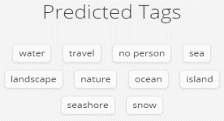

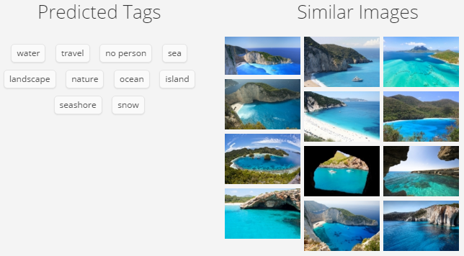
Computers can see
Source: http://www.clarifai.com/, http://imageannotator.cs.tau.ac.il/

Slide 5
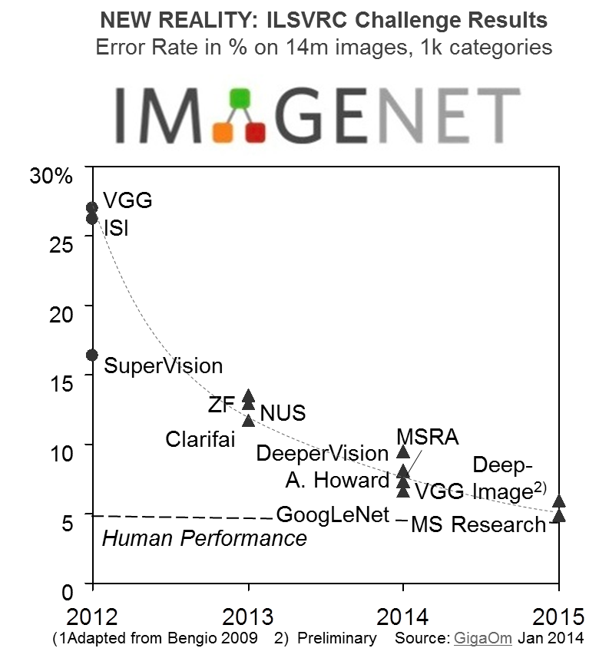
They are now better than us at image labelling

Slide 6
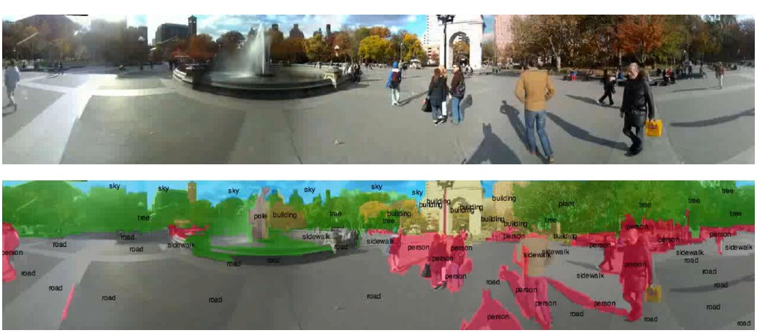
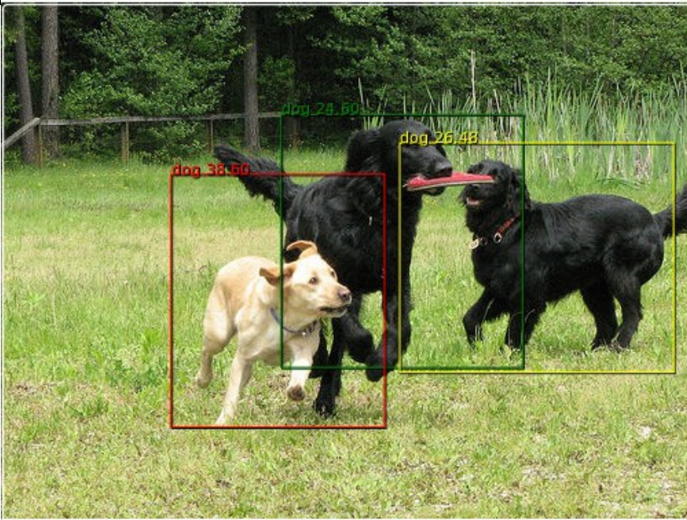
Computers can detect objects and segment scenes
Sources: LeCun – The unreasonable effectiveness of deep learning, Zeiler - Visualizing and Understanding Convolutional Networks

Slide 7
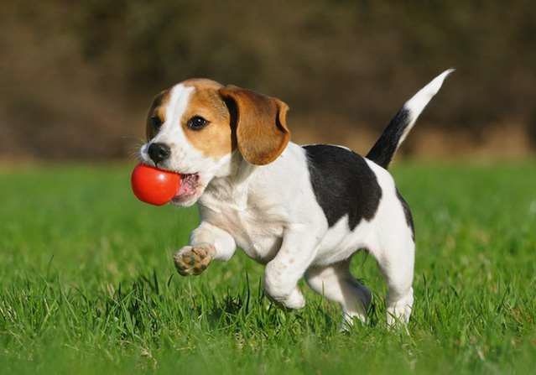

Computers can describe images
, almost as well
A dog with ball in its mouth
A skier is jumping over snow covered hill
Source: http://www.clarifai.com/, http://imageannotator.cs.tau.ac.il/

Slide 8
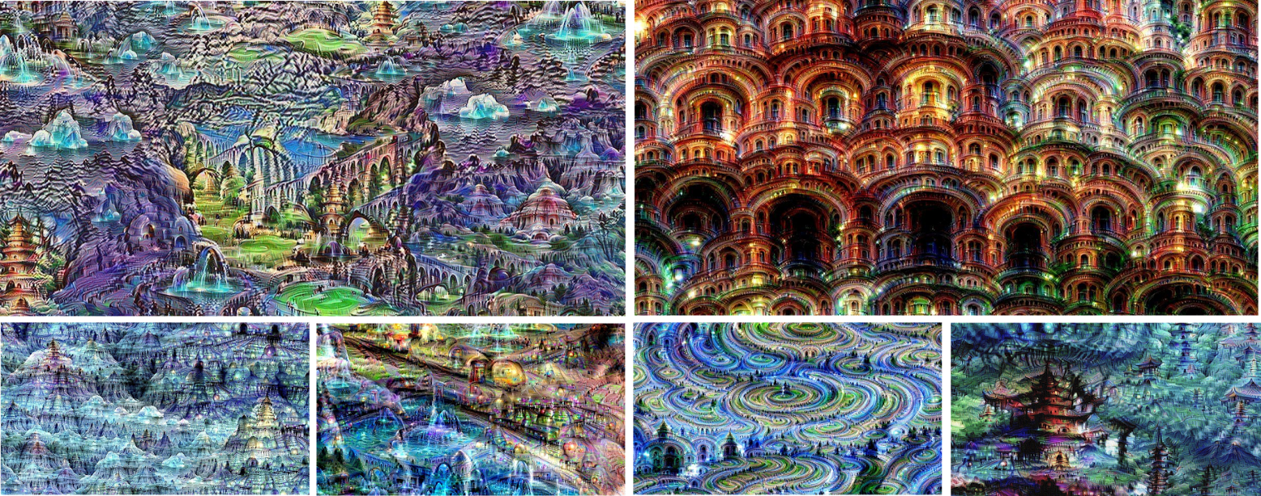
Computers are starting to dream
Source: http://googleresearch.blogspot.co.il/2015/06/inceptionism-going-deeper-into-neural.html

Slide 9




Computers can “get” words
Source. https://code.google.com/p/word2vec/

Slide 10
Computers can “get” words
Stock Market ≈ Thermometer
Human - Animal = Ethics
Library - Books = Hall
Iraq - Violence = Jordan
President - Power = Prime Minister
Obama + Russia - USA = Putin
Politics - Lies = Germans
Source: http://byterot.blogspot.co.il/2015/06/five-crazy-abstractions-my-deep-learning-word2doc-model-just-did-NLP-gensim.html

Slide 11
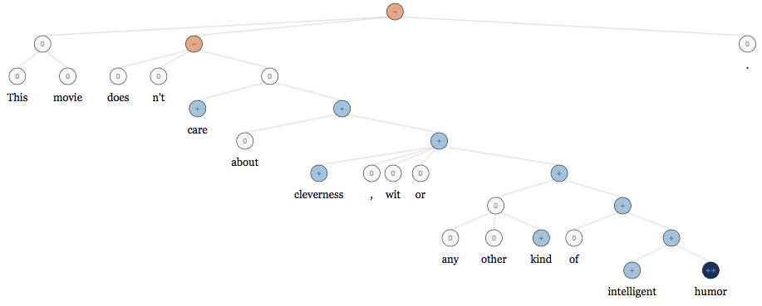
Computers can “get” sentences, too
Stanford NLP Sentiment Trees
Source: Stanford NLP team

Slide 12
Computers can write, “almost” like famous authors
VIOLA:
Why, Salisbury must find his flesh and thought
That which I am not aps, not a man and in fire,
To show the reining of the raven and the wars
To grace my hand reproach within, and not a fair are hand, That Caesar and my goodly father's world; When I was heaven of presence and our fleets,
We spare with hours, but cut thy council I am great, Murdered and by thy master's ready there
My power to give thee but so much as hell:
Some service in the noble bondman here,
Would show him to her wine.
KING LEAR:
O, if you were a feeble sight, the courtesy of your law, Your sight and several breath, will wear the gods With his heads, and my hands are wonder'd at the deeds,
So drop upon your lordship's head, and your opinion Shall be against your honour.
Note: 3-layer RNN with 512 hidden nodes on each layer.
Source: The surprising effectiveness of recurrent neural networks, http://karpathy.github.io/2015/05/21/rnn-effectiveness/

Slide 13
Enterprise Machine Learning Agenda
Some surprising new capabilities
Why this is possible, now (let’s deep dive where you are interested)
What competitors are doing
What SAP has done so far
Emerging enterprise opportunities
Our strategy and approach going forward

Slide 14

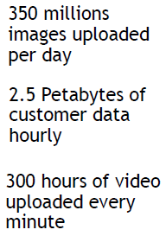
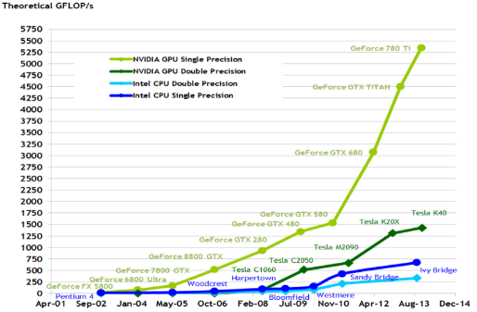

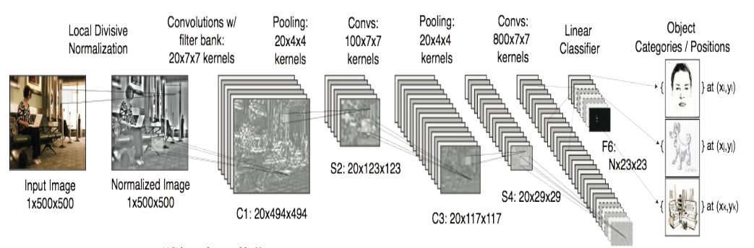

Why is this possible now? Three step changes
Huge Datasets
E.g. ImageNet (14M images)¹, WordNet (155k words in taxonomy)³2 Wikipedia (23bn words in 291 languages)
Massive Parallelism
Tera-FLOPS on consumer GPUs
GPU supercomputer clusters³
$15k DevBox appliance: 28 TFLOPs, 48 GB GPU memory across 4 boards
Better Algorithms
Same backpropagation algorithm Same CNNs, RNNs as in the 1990s
BUT: Deeper
Replacing sigmoid transfer functions with ReLUs, leaky ReLUs Introduction of pooling & softmax layers
GPU
CPU
Key SAP differentiator: we own enterprise data, especially in our cloud
SAP implication: embrace GPU like we have embraced in-memory
SAP implication: embrace leading researchers and open-source
http://www.image-net.org/ 2) http://wordnet.princeton.edu/ 3) https://gigaom.com/2015/01/14/baidu-has-built-a-supercomputer-for-deep-learning/
4) https://docs.nvidia.com/cuda/cuda-c-programming-guide/index.html 5) https://developer.nvidia.com/devbox

Slide 15
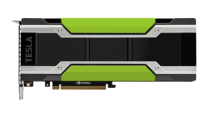
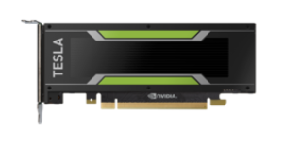
Why is this possible now? Compute power Latest GPUs as of Nov 2015
GPU Accelerator | Tesla M40 | Tesla M4
CUDA Cores | 3072 | 1024
FP32 TFLOP/s | 7 | 2.2
GPU Base Clock | 948 MHz | 872 MHz
GPU Boost Clock | 1114 MHz | 1072 MHz
Compute Capability | 5.2 | 5.2
SMs (version 5.2) | 24 | 8
Shared Memory / SM | 96KB | 96KB
Register File Size / SM | 256KB | 256KB
Active Blocks / SM | 32 | 32
GDDR5 Memory | 12,288MB | 4096MB
Memory Clock | 3000 MHz | 2750 MHz
Memory Bandwidth | 288 GB/sec | 88 GB/sec
L2 Cache Size | 3072KB | 2048KB
Form Factor | PCIe | PCIe Low Profile
TDP | 250 Watts | 50-75 Watts
Nvidia M40
Nvidia M44

Slide 16
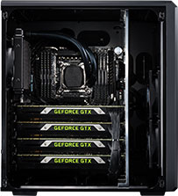
Why is this possible now? Compute power The compute power $15k buys today
Nvidia DIGITS DevBox
Key Features
Four TITAN X GPUs with 12GB of memory per GPU
64GB DDR4
Asus X99-E WS workstation motherboard
4-way PCI-E Gen3 x16 support
Core i7-5930K 6 Core 3.5GHz desktop processor
Three 3TB SATA 6Gb 3.5” Enterprise Hard Drive in RAID5
512GB PCI-E M.2 SSD cache for RAID
250GB SATA 6Gb Internal SSD
1600W Power Supply Unit from premium suppliers including EVGA
Ubuntu 14.04
NVIDIA-qualified driver
NVIDIA® CUDA® Toolkit 7.0
NVIDIA® DIGITS™ SW
Caffe, Theano, Torch, BIDMach
Source: NVidia

Slide 17
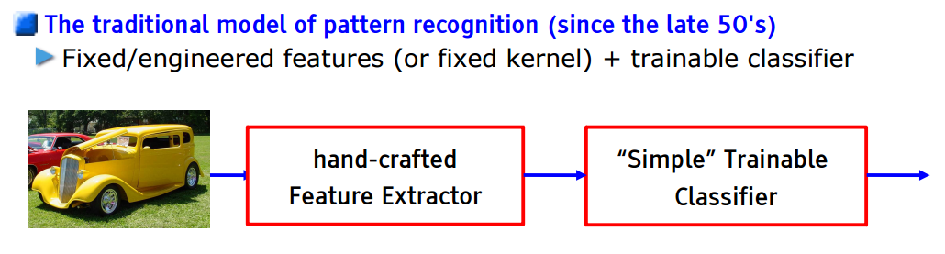
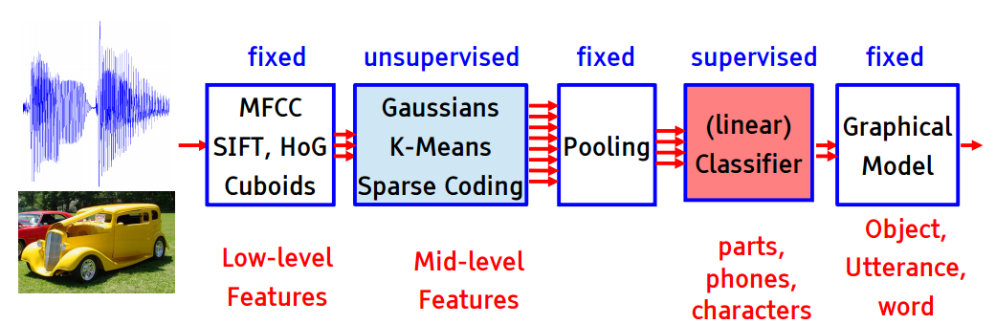
Better algorithms: convolutional neural networks (CNN) Replacing hand-crafted detectors with deep learning
Sources: LeCun – The unreasonable effectiveness of deep learning, Zeiler - Visualizing and Understanding Convolutional Networks

Slide 18
Better algorithms: convolutional neural networks (CNN) A feed-forward architecture with alternating layer types
Sources: LeCun – The unreasonable effectiveness of deep learning, Zeiler - Visualizing and Understanding Convolutional Networks

Slide 19
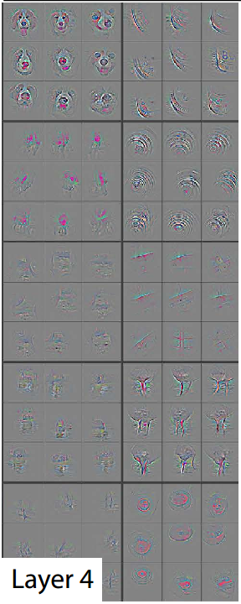
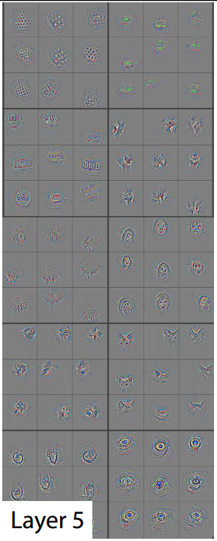
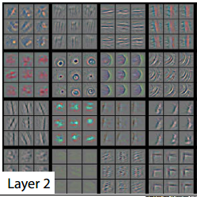
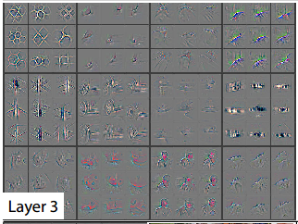

Better algorithms: convolutional neural networks (CNN) Learned filters show progressively more complex features
Sources: LeCun – The unreasonable effectiveness of deep learning, Zeiler - Visualizing and Understanding Convolutional Networks

Slide 20
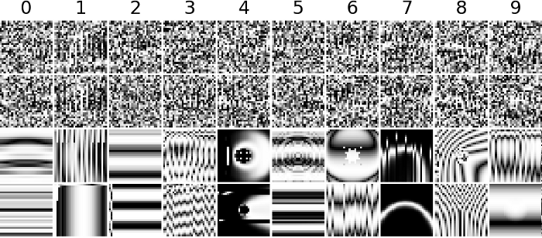
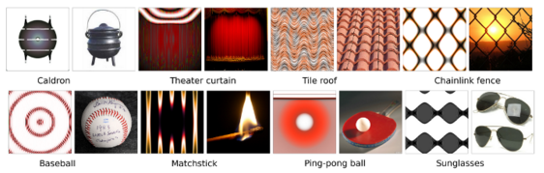
Limitations: DNNs are easily fooled (Nguyen, Yosinski, Clune 2015)
Approach
Genetic algorithm
Feed some obviously meaningless images into a CNN (e.g. random noise)
Pick the kinds of noise that generate the strongest confidence signal for a classification
Cross and mutate the most misleading images to generate the next generation of test images
Repeat until desired false confidence level reached
Impact
Can reach 99%+ confidence for obviously wrongly labelled images
Reflects that CNNs are simple feedforward, piecewise linear functions
Reflects that competition CNNs are usually trained without an “other” category (nobody is feeding them meaningless images in the competition)

Slide 21
Better algorithms: Word2Vec learns a word from its context, unsupervised, by reading large text corpora
Network Setup (illustrative)
Approach
Learn a word from the context of other words it appears with
Train simple feed-forward network to predict the middle word
Unlabeled data, just read Wikipedia
Simple dictionary approach: assign numbers to words
Simple additive approach: continuous bag of words model
Use weight matrix as vector encoding of a word
Use cosine distance on these vectors as similarity metric
Benefits
Fixed length encoding
Log(n) length (not n, as in one-hot encoding)
Some degree of robustness (like noise coding)
Usage of words in similar contexts encoded into vector space (can feels like “semantic” encoding at first glance)
Input word 1
2
Predicted word 3
4
5

Slide 22
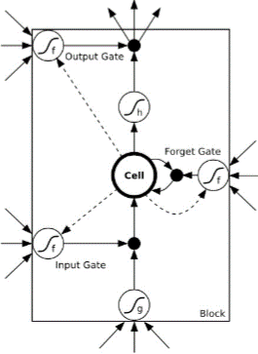
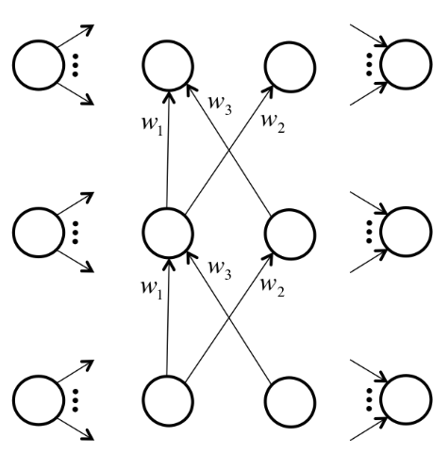
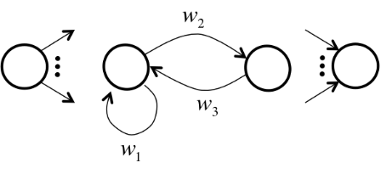
Better algorithms: recurrent neural networks (RNN) Backward references to deal with the flow of time in text, speech, video
RNNs can have cycles (and hence be stateful)
Can train with backpropagation (by unrolling in time)
Long-short-term memory neurons (input, output & forget gates)
Sources: Schmidhuber LSTM paper, http://nikhilbuduma.com/2015/01/11/a-deep-dive-into-recurrent-neural-networks/

Slide 23
Enterprise Machine Learning Agenda
Some surprising new capabilities
Why this is possible, now
What competitors are doing
What SAP has done so far
Emerging enterprise opportunities
Our strategy and approach going forward

Slide 24
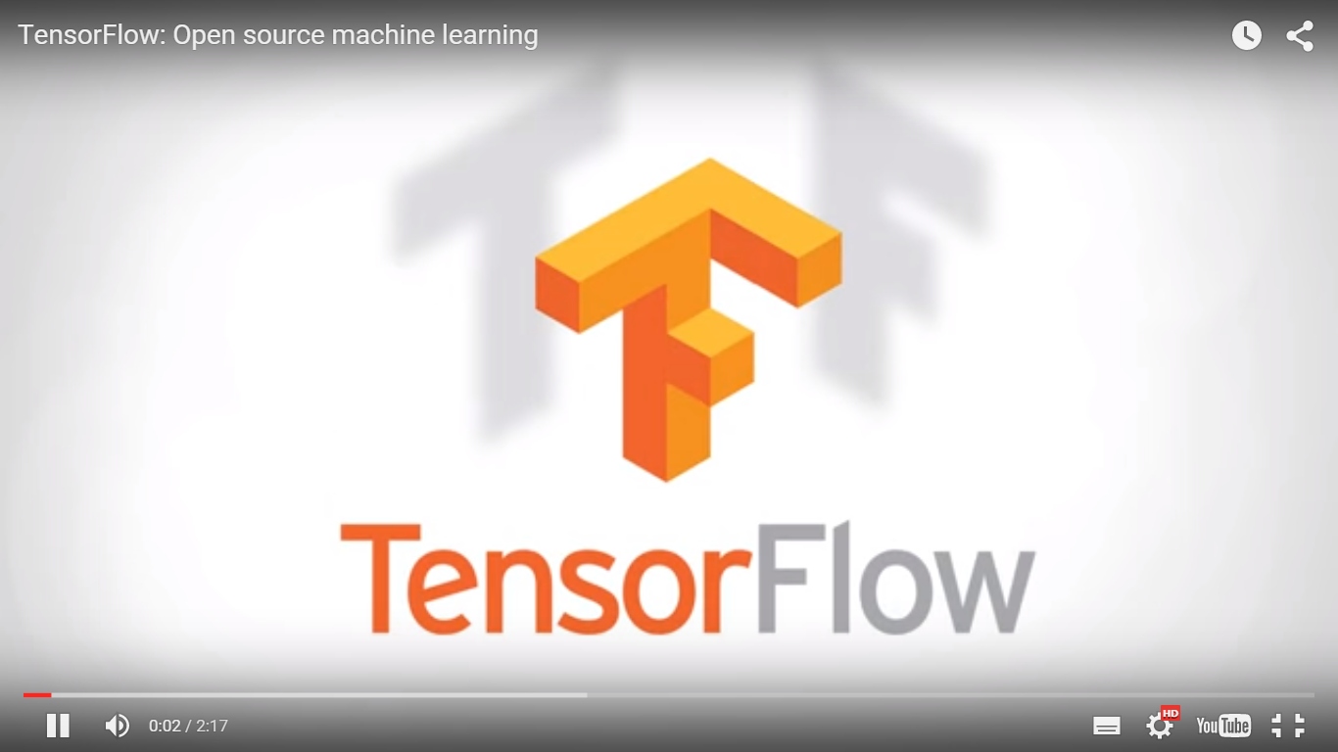




Competitors are moving boldly in machine learning Latest news: Google open sources TensorFlow
Nov 2015
Competitor
Actions
Focus
 | Watson $1b invest AlchemyAPI, Visisimo, Cognea, Merge M&A ($1 bn++) | Medical, Watson on Bluemix, Analytics Services
 | TensorFlow launch DeepMind, Like.com, Metaweb M&A ($850m) | DeepMind, Now, Driverless Car, Google Robotics
 | Azure ML invest Rev. Analytics, Equivio, Aorato M&A ($400m+) | Adam, Cortana, Skype Translator, ML on Azure
 | RelateIQ, Tempo M&A ($400m+) | Intelligent CRM
 | LookFlow, IQ Engines, Summly M&A ($30m+) | Social media UX, Flickr tagging
Strengths
Equally for vision and text
Supports CNN, RNN, word2vec, Seq2Seq….
Heterogeneous GPU processing
Python and C++ API
Open source
Weaknesses
Instable with higher batch sizes.
Small developer community
Sources: Crunchbase, investor relations web pages, news clippings; Anil Ankisettipalli hands-on review

Slide 25
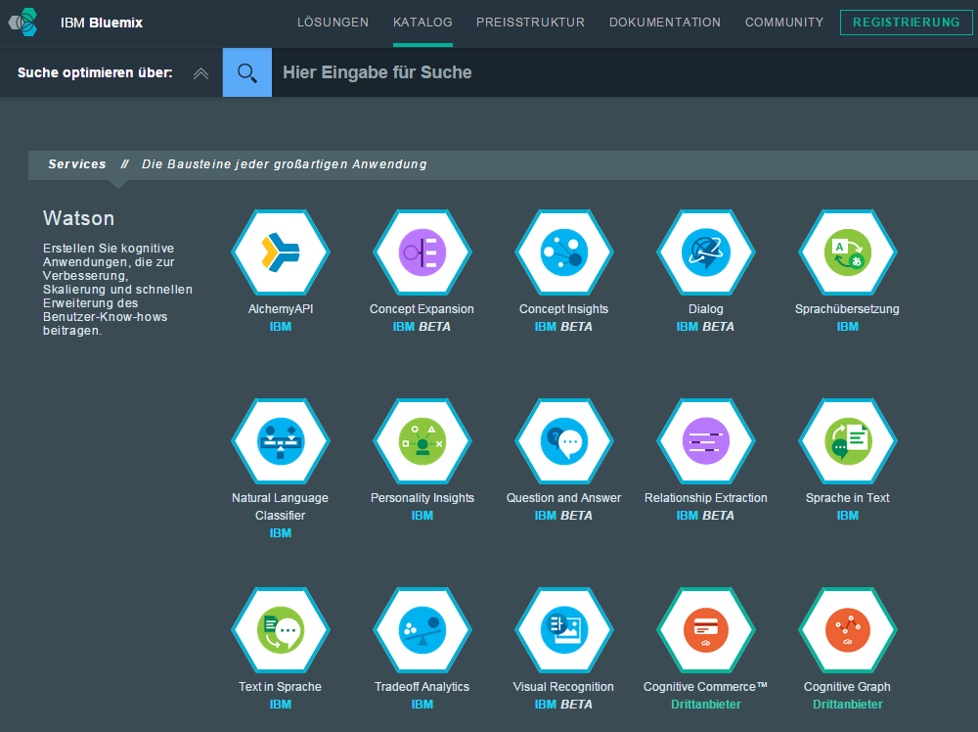
Competitors: IBM Watson Services on Bluemix 15+ services incl. NLP, sentiment, image analysis, speech
Key idea: Cognitive and machine learning capabilities are key differentiators for next-generation apps
A platform which seamlessly provides these services has an edge over competing platforms
Faced with the choice which platform to build on, richer functionality may win
In-memory alone is no longer differentiating, as e.g. DB2 BLU is also on BlueMix
See also: Azure ML
Note: Outside-in, not technically validated bottom-up Source: Company website, see link(s) in header

Slide 26
Competitors: IBM Watson background
Build-and-buy strategy with patient capital even in the great recession
1998
Initiation
2011
Publicity
2013-2014
Acquisitions
2014
ML Unit
2014-2015
ML Acquisitions
2015
Venture Capital
First research begins
Watson wins Jeopardy! Contest
SoftLayer IaaS/Paas ($2b)
Cognea General Purpose ML/AI
Silverpop domain apps
Watson BU in NY, PA to employ 2,000 people with $1b invest
Over $2b, incl.
AlchemyAPI (voice), Merge (health), Phytel, Silverpop, Blekko
$100m fund for startups building on the Watson platform
http://www.infoworld.com/article/2886132/machine-learning/how-machine-learning-ate-microsoft.html
**SAP CMI Report Apr 2015
For sources, see slide “Case Study: IBM Watson Evolution”

Slide 27





















































Competitors: ML/DL Startup Landscape July 2015
Solutions
Finance
Fraud
Legal
HR
Medical/Diagnostics
Agriculture
Hori- zontal
Ver- tical
Machine Learning
Platform
Building Blocks
Multiple
Image Recognition
NLP
Speech Recognition

Slide 28
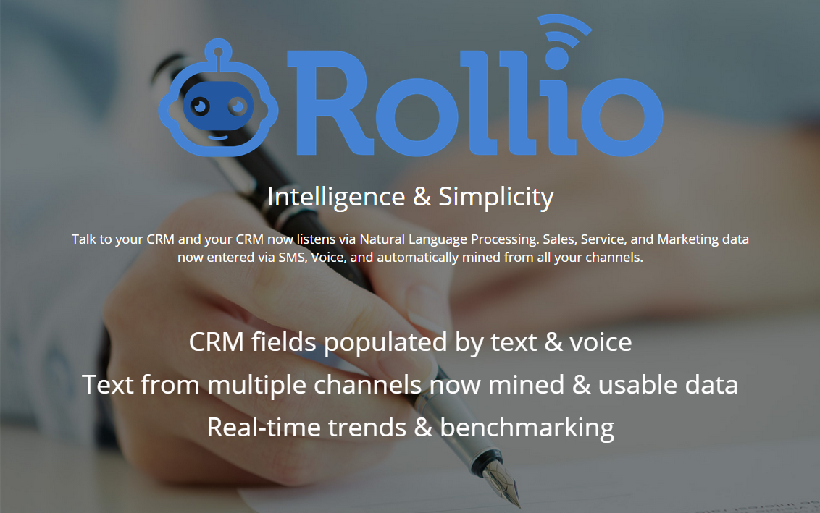
Cognitive Apps: Rollio startup at NYU accelerator Auto-fill CRMs from natural communication
Key idea: People hate filling structured fields with validation rules, but love to chat about their progress
Let’s take these messages and auto-populate the tedious backend fields
E.g. fill CRM from “we had a good meeting, will likely close for $250k of product X by end of quarter”, plus context info (calendar, …)
Leverages Stanford NLP, gMail integration, …
Applied universally, this approach could detach users from all legacy transactional applications
Note: Outside-in, not technically validated bottom-up Source: Company website, see link(s) in header; personal meeting with founders, NYC Jul 2015

Slide 29
Competitors: Open Source Much technology available, still hard to consume
CAFFE
declarative specification and simulation of arbitrary DNNs
Python/Bash that can run on NVIDIA’s cuDNN
Developed by the Berkeley Vision and Learning Center and contributors
TORCH
scientific computing framework implemented in LuaJIT
Runs on NVIDIA’s cuDNN
Torch is used by Google DeepMind, Facebook AI Research Group, IBM, Yandex and the Idiap Research Institute
FB released multiple open source contributions to NN
TensorFlow
Equally for vision and text
Supports CNN, RNN, word2vec, seq2seq, ….
Graph based mathematical models
Heterogous GPU processing
Python and C++ API
Released by Google in Nov 2015
Good initial feedbacks
Community still very small
MADlib
Big Data Machine Learning in SQL for Data Scientists
Provides Classification, Regression, Clustering on Postgres, Pivotal Greenplum Database, and Pivotal HAWQ
began as collaboration between researchers at UC Berkeley and EMC/Greenplum (later Pivotal).
Deeplearning4j.org
commercial, open-source, distributed deep-learning library written for Java, Scala and Closure.
Integrated with Hadoop and Spark
distributed by Skymind, a San Francisco-based business intelligence and enterprise software firm
THEANO
Python library that evaluates mathematical expressions involving multi-dimensional arrays efficiently
Computations are expressed using a NumPy-like syntax and compiled to run efficiently on either CPU or GPU architectures
open source project mainly developed by a machine learning group at the Université de Montréal

Slide 30
Enterprise Machine Learning Agenda
Some surprising new capabilities
Why this is possible, now
What competitors are doing
What SAP has done so far
Emerging enterprise opportunities
Our strategy and approach going forward

Slide 31
Prior SAP Efforts in ML/DL Concentrated in structured data, underinvested in new domains
Known ML/DL Efforts @ SAP
Key Figures ML/DL @ SAP Best Estimate R4Q
Std. Product
Custom Dev.
Co-Inno-vation
Research
 | Tabular | Time-series | Text | Image/Video | Speech
 | Structured |  | Unstructured
HANA PAL
APL / KXEN
~170 FTE
~25 M€
100%
hybris predictive
Core ML/DL
Image¹⁾
9
2
RTOM
SAS Integ.
Text mining
Text²⁾
27
5
Rela- ted areas
Time series
6
SCAL
UDF
IoT Pr. Maint.
Cloud for pred. an. svc. ( RTC open 9/2015 )
FS systemic risk analysis
Learning semantics with NNs
Brand logo detection
Travel mode detection
Face detection & analysis
Tabular³⁾
121
17
Product Recom. Engine
Applied ana. of multidim. time series
Clothes recommender
HANA Self-Tuning
Facial emotion recognition
P&I Staff
Revenue
1) Incl. Video 2) Excl. HANA search team of ~30 FTE 3) Mainly APL/KXEN, PAL, predictive maintenance, RTOM Note: Revenue may be overstated due to bundling Sources: PO interviews, people.sap.com, revenue by mat.
Vertical solution
Horizontal sol.

Slide 32









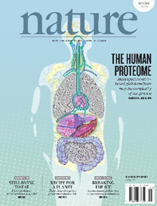



But besides the unfair advantage of owning enterprise data, we can also draw on strategic partnerships created in 2015
ICN MLI Strategic Research Areas
Partners Signed (since Q1 2015)
// ML for Enterpise Apps
$5.2T market by 2025
Big data, deep learning
Assistive, contextual, (semi-)automation
Columbia
// ML for Personalized Medicine
$1.1T market by 2025
Individual treatment, prevention
Advances in sequencing, medical imaging, medical text
TU München
…
Tel Aviv University
U Amsterdam
Koc University

Slide 33




New Research @ SAP 2015 Enterprise Machine Learning (~10 PhDs)
Cluster | Topic | Partner | Status
C4C | Customer Lifetime Value | ESSEC Business School | Live
 | Basket Abandonment Prediction | MIT featurelab | Signed
TripIt | Vendor Cleaning | HPI | Live
 | Replacement of Regular Expressions for TripIt | University of Tel Aviv | Live
Ariba | Semantic Analysis of Texts in Transaction Networks | University of Amsterdam | Signed
 | Deep Collaborative Clustering and Prediction |  | Signed
sFin | Macroeconomic Connectedness Analysis | Koç University | Signed
 | Financial Network Connectedness Analysis |  | Signed
Success Factors | Team Fit and Value of Networks | Stanford University | Signature Pending
 | Deep Content Classification for Learning | Columbia University | Contract Negotiation
 | Career Paths for Retention and Leadership | New York University | Contract Negotiation

Slide 34
New Research @ SAP 2015 ML for Personalized Medicine (~10 PhDs)
Cluster | Topic | Research Partner | Status
Medical Text | Medical concept recognition | DFKI Berlin | Live
 | Intelligent Patient Summaries | Harvard-MIT HST | Live
Proteomics | Drug sensitivity and resistance prediction | TU München | Signed
 | Multi-OMICs |  | Signed
 | Proteomics Analytics |  | Signed
Platform | Clinical data warehouse | CBmed | Signed
 | Subsequent cross-silo analyses | Cbmed | Signed
Genomics | Prediction of drug sensitivity in cancer | DKFZ Heidelberg | Contract Negotiation
 | Phenotyping & Patient Cohorts | NYU | Topic Definition
Status Pipeline:
Topic Definition
Contract Negotiation
Signature Pending
Signed
Live

Slide 35
Enterprise Machine Learning Agenda
Some surprising new capabilities
Why this is possible, now
What competitors are doing
What SAP has done so far
Emerging enterprise opportunities
Our strategy and approach going forward

Slide 36
The market opportunity in enterprise machine learning is huge
Enterprise ML Market Size
Key Drivers
$11.0b
All apps become smart apps
Unstructured data drives new value creation
Natural language and speech as the default UI
49% CAGR
$0.2b
2014
2024
Source: Based on Tractica AI study Q2 2015 6) Crunchbase, investor relations web pages, news clipping

Slide 37
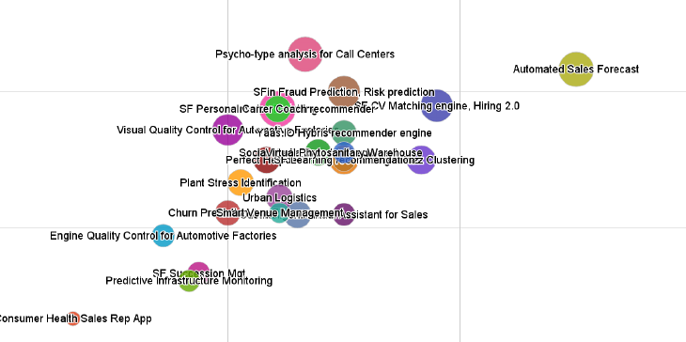
SAP has identified 40+ ML use cases, and the top four are kicking off development week of Jan 18 towards SAPPHIRE
ML Use Case Segmentation
Immediate Start towards SAPPHIRE
Success Factors CV matching (Hiring 2.0)
Cloud for Customer automated sales forecast
Cloud for Customer social buzz clustering
Hybris yProfile smart customer profile
Attractiveness
Rapid Further Validation
JAM automatic employee engagement
JAM social recommendations/personalization
SFSF configuration recommendation engine
SFSF customer community idea tagging
S/4 HANA sFin invoice matching
S/4 HANA sFin fraud prediction
S/4 HANA sFin risk prediction
IoT predictive maintenance
Ability to execute
Source: Use case interviews withSAP L1 units, ICN MLI prioritization Jan 13 2016

Slide 38

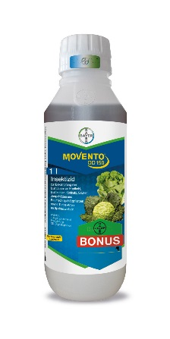
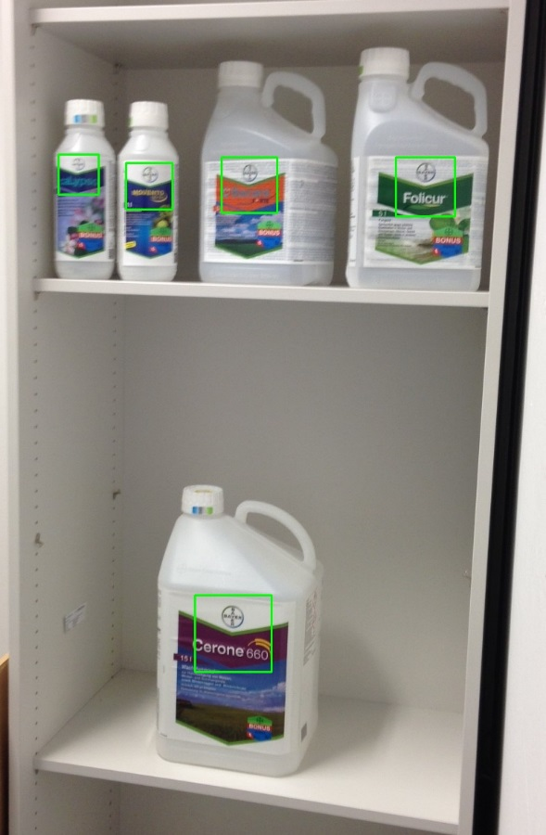




Paid PoC: Bayer Crop Science looking to detect products in images to check safety & create digital sales channel for reorders
Use Case
Training Set¹⁾
Sample Output²⁾
Problem
Crop science products can be hazardous unless stored correctly
Checking storage compliance is hard
Re-orders driven by fluid levels on-site
Solution: Empower farmers with mobile app
Identify products with computer vision
Lookup and validate storage compliance
Create digital channel for instant re-orders
1) Minimal training set of 8 package shots provided by customer, augmented by team with rotations/shears etc 2) After ten days of project

Slide 39
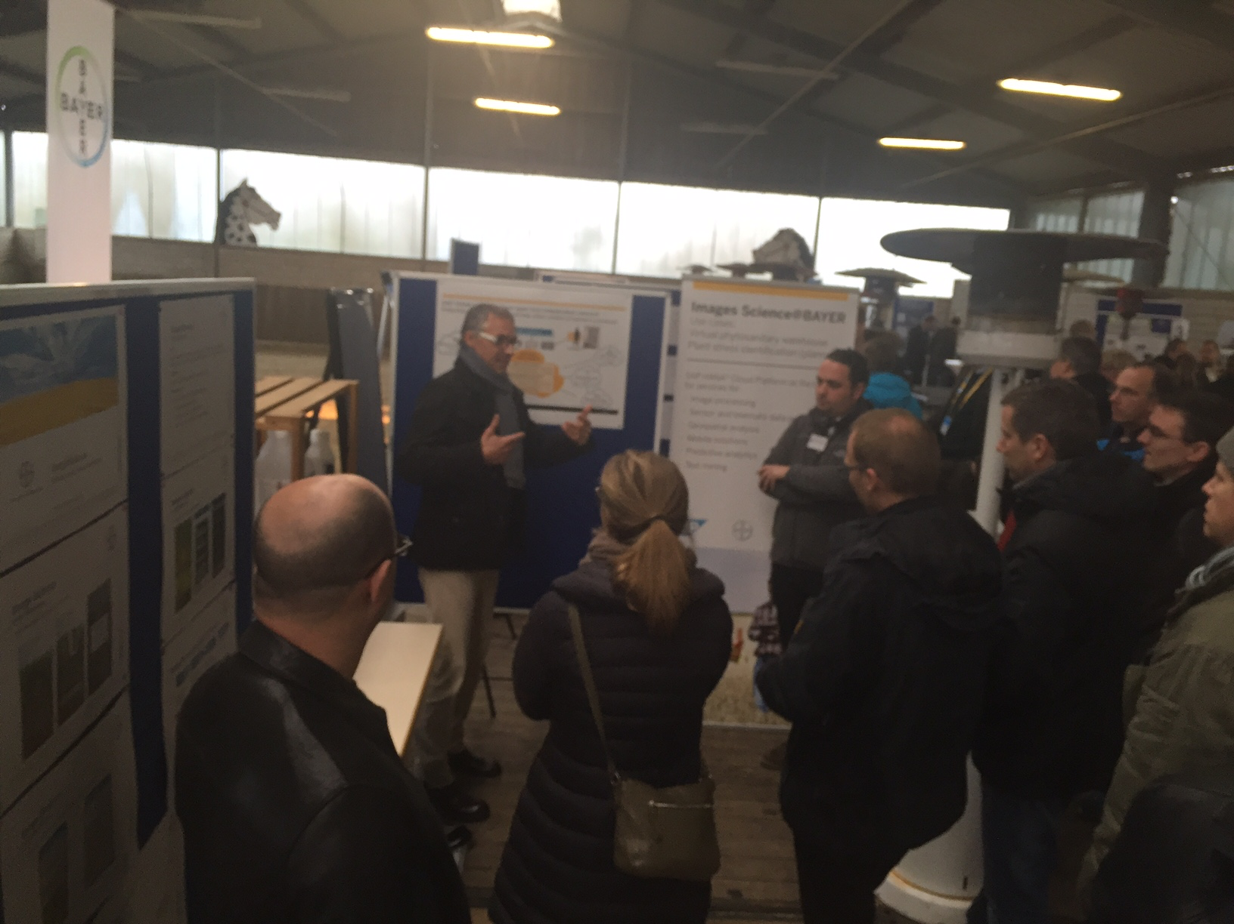
Paid PoC: Bayer Crop Science - outcomes
POC Follow Ups
On-site PoC worked well
Current PoC is limited by available data (~10 packshots plus data augmentation)
Significant improvements with pictures taken onsite
Bayer will work on generation of a large dataset which will enable us to train more accurate classifiers
1) Minimal training set of 8 package shots provided by customer, augmented by team with rotations/shears etc 2) After ten days of project

Slide 40

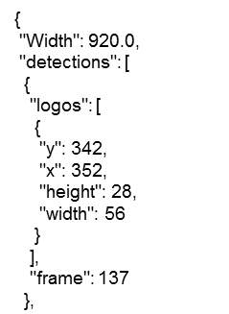

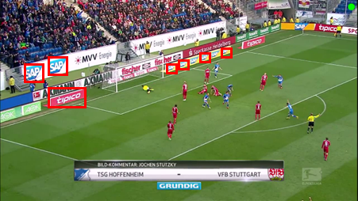
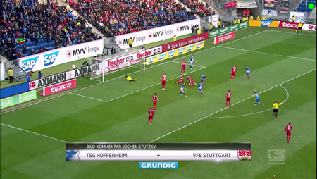

SAP Brand Logo Recognition: We can recognize customer logos in video to generate brand exposure statistics
Video Upload
Detection Algorithm
Post Processing
Store in HANA
Detects and recognizes brand logos in video and images.
Can detect and classify multiple logos and generate reports on logo exposure
E.g. number of appearances, location on frame and size.

Slide 41
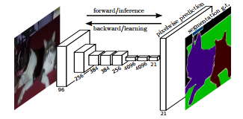


SAP Brand Logo Recognition: This works with a two-stage convolutional neural network: first detect, then classify
Detection + Classification at once for all logos
Stand alone caffe engine
Very fast (~25ms per image)
Powered by Nvidia Kepler GPUs for training

Slide 42

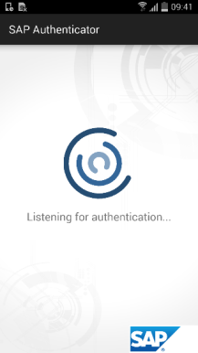
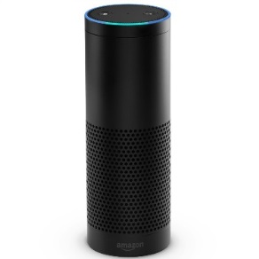






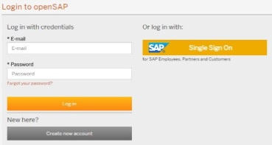

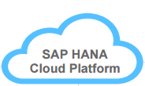
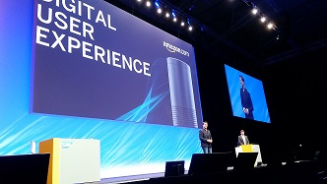
TechEd Showcase: Hands-free travel booking by extendin Concur with Amazon Echo, Evature and Prontoly
“Alexa start sap”
“Alexa ask sap to book me a flight from Boston to Chicago”
“Alexa play log in” // Open Prontoly App Is needed
“Alexa ask sap to book me a flight from Boston to Chicago”
“November first”
“Alexa ask sap to book me a hotel in Chicago”
“November first “
“Three nights”
Implementation video: https://youtu.be/KBrCy6d9_No
Notes:
THE USE CASE
Booking a flight and hotel from the company’s travel agency instantaneously, where the flight is on specific dates and the hotel should be close to our business destination which could be a customer’s office, a corporate branch or a prominent place e.g. the Eiffel tour.
THE SOLUTION
Voice enabled device connected to business cloud services with travel booking solution. Where:
Voice enabled device is Amazon Echo Voice Enabled Device for Business;
Business cloud services is SAP HANA Cloud Platform for business via SAP Cloud For Customer;
Travel Booking is SAP Concur;
User authorization is provided leveraging Prontoly ultrasonic proximity-based authentication signature;
Natural Language understanding is provided by the Evature Expert Virtual Agent (EVA).
THE FLOW
User is authorized to access SAP services by activating Alexa: “Alexa start SAP”
The hands-free authentication process takes place in the background ultrasonically via microphones and speakers that each device (mobile phone and Amazon Echo) is already equipped with. Sound, imperceptible by the human ear, is played by the authenticating device (Amazon Echo) and is heard by the mobile device equipped with Prontoly. A special handshake between the mobile device and the login page (SAP HANA Cloud Platform Application) occurs through Prontoly’s Sound Tokenization technology and then the device equipped with Prontoly sends the verification to the application requesting authentication. During the authentication process, no passwords or user sensitive data are transmitted over the sound so it is impossible for anything to be sniffed or reproduced.
User books travel from SAP Concur “Alexa ask SAP to book me a flight from X to Y”
Unstructured text is passed from Amazon Echo (Alexa) to Evature’s Expert Virtual Agent (EVA) for Natural Language understanding. Eva’s dialog engine completes missing information by conversing with the user and when sufficient information is gathered, a structured query is delivered to the Concur API via HANA Cloud Platform Application. Concur contacts Booking.com and GDS to receive the alternatives and returns the answer via API. The answer is being played to the user by Amazon Echo (Alexa). The user selects the desired flight and asks for a hotel. He doesn’t need to specify the date or the location, since Eva infers the information from previous utterances in the conversation already stored those in the complex object in the application on SAP HANA Cloud Platform.
Technical Implementation:
Download the authentication sound file from Prontoly website and upload it to your Amazon account Link (Prontoly to provide the file generation service);
Download and install the Prontoly authentication application to your mobile device Link (Prontoly to provide the app generation service);
Book SAP HANA Platform Trial instance;
Deploy the Travel Booking Java Application (Appendix I);
Install Amazon Alexa Web Plugin or use the real Echo device (see development guide in Appendix II);
Acquire access to the Evature Sandbox on AWS Link (register for a free Evature account at https://www.evature.com/registration/form);
To further extend or change your HCP application, use the following Concur APIs Link (you can access the link to the original article on Evernote or follow the steps in Appendix III);
The explanation on the usage of SAP Cloud For Customer (C4C) is in Appendix IV.

Slide 43
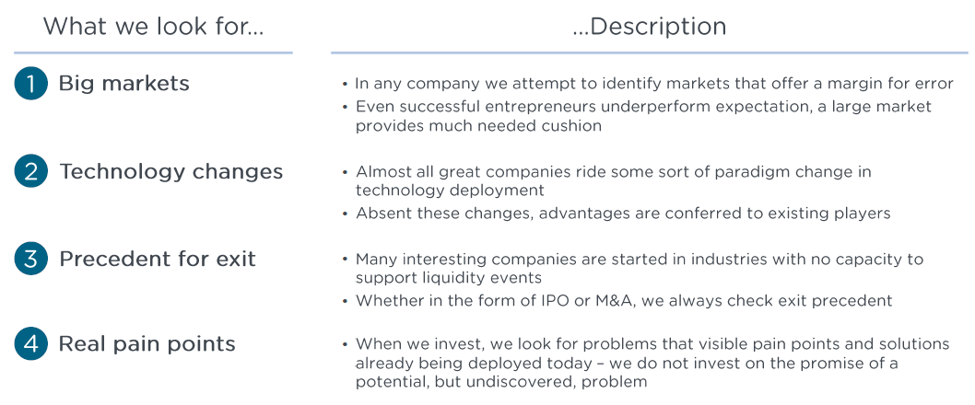
Overall, Enterprise ML meets SAPPHIRE Venture investment criteria
✓
✓
✓
✓
Source: SAPPHIRE Ventures keynote to ICN, Dec 1 2015

Slide 44
Enterprise Machine Learning Agenda
Some surprising new capabilities
Why this is possible, now
What competitors are doing
What SAP has done so far
Emerging enterprise opportunities
Our strategy and approach going forward

Slide 45
Should we make, buy or partner? As ML is strategic and we are not already losing deals, make & buy is recommended
Is it urgent? (<12 months)
Machine learning radically redefines …
how business apps deliver value
how users interact with business apps with natural language, voice etc.
SAP needs to own this strategic differentiator…
to unlock a growth trajectory in apps beyond S/4
to position our platform as go-to place for smart apps
to differentiate out DB by pushing down functionality
Our unfair advantage is we own the data, especially in the cloud: Ariba, Concur, Fieldglass, hybris, Jam, SFSF
No
Yes
Make (recomm.)
Buy (fallback)
Yes
Is it stra- tegic?
Defer or approach tactically (not an option)
Partner (not an option)
No
Significant customer interest and emerging pipeline in ML cases, but currently no indication we are already losing major suite deals because of ML capabilities
This indicates we likely have the runway required to build, with option to accelerate via tuck-in/medium-size M&A
Partnering e.g. with IBM could drive some short-term revenue
But would create a bleak medium-term scenario:
Our apps become remote-controlled transactional backends
HCP fails to take off as IBM Bluemix becomes platform of choice
HANA commoditizes as we cannot push down ML features
We would trade away our high-value data assets for infrastructure

Slide 46
Make: SAP can become a force in enterprise ML by combining organic investment with selective M&A
Core Beliefs
Proposed Approach (partly overlapping)
Apps led, based on customer & SAP datasets
Maximally leverage open source technology
Incubation unit structure by ML domain
Semi-structured
Image/video
Text
Speech (prio 2)
Subsequently deliver reuse services
Main target HCP¹⁾
HANA, Vora on-premise as appropriate
1
2
3
4
Start ML Research (2015)
Identify medium-term use cases
Identify data assets
Identify and contract top universities
Launch ~20 PhD initiatives with business sponsors (runtime: ~3 years)
Form ML in-cubation unit (Jan 1, 2016)
Identify and collect ML assets in SAP
Setup ML incubation team with key assets
Augment with targeted hiring
Prioritze short-term use cases
Make first apps smart (H1 2016)
Staff and kickoff 4-5 dev projects to bring ML to exis-ting products, leve-raging open src.
Focus on cloud, as we have data
Deliver for SAPPHIRE 2015
Scale ML across SAP
(H2’16 - 2017)
More own projects for exist. projects
Multiply across SAP with dev. edu.
Push ML services down to platform (HCP, HANA)
Start incubating new apps
Selective M&A
✓
✓
…
1) Following yaaS model: build services in incubation units, reintegrate into HCP 2) E.g. Amazon Mechanical Turk

Slide 47
Make: Implementation is driven by an Innovation Center Network ML Incubation unit created Jan 1 which spans Germany, Israel and Singapore
ICN Jürgen Müller
HRBP C. Deller
MLI Research COO
Irina Suppanz
MLI Markus Noga
Assistant S. Schäfer
Controlling F. Holeisen
MLI Research: Pers. Medicine Tassilo Klein TL + ~10 ext. PhDs
MLI Research: Enterpr. apps Abdul-Saboor Sheikh TL + ~10 ext. PhDs
MLI Core to Cloud Zbigniew Jerzak + existing working students + 10 open HC
MLI & Startups Germany Sebastian Wieczorek + existing team, working students + 6 open HC + friends of SU
MLI Israel Mike Kemelmakher + existing team + 4 open HC
MLI Singapore Steve Lee + existing team
MLI Future SOC Lab Helge Gose TL Sascha Hellmann + existing working students
SIG ML Chair Ran Bittman / MLI Israel

Slide 48


Make: ML platform outlook Subject to confirmation in customer pilots
Current
Existing Roadmap
New for ML/DL
Customer View
Cloud Cockpit
App Center
Service Fabric
Bus. Svc.
Storefront
Billing
…
…
R¹⁾
Lumira
Portal
Fiori aaS
Redis
Stanford NLP²⁾
OpenCV
Partner APIs³⁾
ML & DL Services⁴⁾
CAFFE
PaaS
PaaS Services
HCI
Mobile
HANA/Vora
PostgreSQL
CMU Sphinx
Docs
Security
Rabbit
Mongo
Anaconda
Torch
Cloud Foundry
Core Comp.
IaaS
Open Stack
AWS
Azure
Data Center
SAP Data Centers
Non-SAP Data Centers
1) Proper R itself, not the R connector which is part of HANA 2) Integrate into HANA to enhance existing text capabilities, expose low-cost API on HCP 3) MetaMind, ClarifAI, Nuance 4) Feedback from HCP: please implement in business unit first, e.g. ICN, then integrate back into HCP, following the hybris yaaS model

Slide 49
Key success factors (besides managing expectations)
Razor focus on building a business (not one-off showcases)
Picking and choosing the right segments to go after with our limited bandwidth (i.e. SAPPHIRE’s large, fast growing markets facing tech disruption)
Generating and rapidly pursuing the right PoC opportunities inside each segment (i.e. proof points for validating the business and the technology; not peripheral tangents)
Attracting ML talent (competition is fierce)
Attracting data (it’s the fuel)

